Slide 1

Beauty Advisors
(fictional company)
17 February 2021
Head of Sales,
Head of Customer Experience,
Head of Digital Transformation
Notes:
Problem Statement
Going to a department store for finding cosmetics might not be that easy under Covid. Beauty Advisors (BAs) in department stores are key persons to recommend products based on skin condition, suggest colors for make-up and show make-up hints, following up with customer history.
Target Audience
Head of Sales,
Head of Customer Experience,
Head of Digital Transformation
Spoken Content
Good [whatever] [whoever], the problem I'll be addressing today concerns the predicament of Beauty Advisors working under the restrictions caused by Covid.
The heads of function I'll like to target are the Head of Sales, Head of Customer Experience and Head of Digital Transformation.
For this presentation, I'll be pitching solutions built with Google Workspace and Google Cloud to a fictional company named Goophora. Goophora is based in Singapore and currently has many Beauty Advisors under its employment.
I'll demonstrate how Google can help Goophora transform and streamline its Beauty Advising operations to better serve the needs of its customers and to tackle restrictions imposed due to Covid.

Slide 2
Beauty Advisor’s Role
Product Education
Educate customers on the proper use of beauty products.
Demonstrate to customers techniques to achieve the best aesthetic/physiological effects with beauty products.
Keep up with latest beauty trends and serve as tastemakers for customers.
Personalized Service
Understand customers’ needs based on their skin, hair and beauty regiment.
Make personalized recommendations to best suit customers’ needs.
Drive Sales
Achieve sales quota set by manager/company.
Inventory Management
Monitor and manage available product stock.
Notes:
Spoken Content
Without further ado, let's first understand what are the responsibilities of a Beauty Advisor. Beauty Advisors are the customer's personal advisor to all things related to cosmetics and beauty products. They give advice and show customers how to use products. They also recommend products to customers based on the customer's goals and needs, while taking into account prevailing beauty trends and company sales targets.
Beauty Advisors may also be required to handle some administrative tasks like managing the store's inventory.

Slide 3







Covid-19
Circuit Breaker : Phase 3 Relevant Measures
Social distancing of at least 1m per person
Venue capacity limits (1 person per 8 sqm of usable space)
Mask on for all
WFH as default mode
Virtual meetings as much as possible
SafeEntry check-ins/Contact tracing
No product testers/samples allowed; Staff not allowed to apply products on customers
Cleaning & disinfection of hands, common spaces & shelves
10
NO SAMPLES
ALLOWED
Notes:
Source: https://covid.gobusiness.gov.sg/guides/retailsmrrequirements30Jan.pdf
- Joint Advisory by Enterprise Singapore, HDB, STB, URA: Advisory for Phase 3 Re-opening of Retail Establishments and Lifestyle-Related Services
Spoken Content
This means that a large portion of a Beauty Advisor's job is customer facing and has to be done on-premises. Due to Covid and the restrictions imposed by the government, these functions have been severely impacted. It has become really inconvenient, if not impossible for Beauty Advisors to perform their jobs.
This is thus a great reason to examine the workflow of a beauty advisor and figure out how to improve on it to manage the current situation. With Google, we can help transform the workflow and create better outcomes.

Slide 4
2018 Market Research Report
Wakefield Research
1500 female beauty consumers surveyed
71% use mobile phones to do online research while shopping in store
68% do online research before making a purchase in-store
70% are overwhelmed by the number of beauty products
66% prefer to be left alone while shopping in store
80+% have positive opinions about use of virtual beauty advisors
49% interested in using virtual beauty advisors
Notes:
Notes:
- Customers prefer to research online & buy in-store [BA can assist in-store, virtual BA can assist online]
Information collection, education and decision mostly made online or from online information sources
This is especially true among Gen Z (88%) and Millenials (86%) -> Do research with mobile phones while in store
- Customers are overwhelmed by number of beauty products [Need to streamline information, provide personalized recommendations]
Confused about product claims & functionality
Confused about comparisons across brands
- Customers positive about virtual BAs [Adopt a human-virtual BA strategy]
No preference between live BA/AI BA
Key is as long as their needs are met
Spoken Content
Even without Covid, the behavior of beauty consumers has already been shifting towards digital. In 2018, Wakefield research published a market research report that examined the behavior of beauty consumers. There are 3 key takeaways from this report.
First, most beauty consumers make the decision to buy online. What this means is that they do their research online before deciding to buy either in-store or online. So, this means that it will be advantageous for Goophora to have a digital presence so that it can be in a position to influence customers during their decision making stage.
Second, beauty consumers are generally overwhelmed by the number of beauty products available. What Goophora can do to alleviate this situation is by streamlining and organizing its product information online. With the suite of services available at Google Cloud, this is a really easy task.
Third, beauty consumers are open to Virtual beauty advisors. In fact, a large majority of them have positive opinions of Virtual Beauty Advisors and believe that with the right technology, they can lead to a more positive and personalized shopping experience. At Google Cloud, there are a host of Machine Learning offerings that can be leveraged on to create this unique personalized experience for Goophora’s customers.

Slide 5













Transformation with Google
Digital Transformation
1
2
Streamlining Information
Streamlining Workflow
3
4
Personalization
Calendar
Meet
Hardware
Cloud Vision
Machine Learning
DialogFlow
Mail
Sites
Sheet
Human
Virtual
Notes:
Spoken Content
With that in mind, here's the proposed strategy to help Goophora leverage on Google's offerings to undergo transformation. We'll be focusing on 4 things - Digital Transformation, Streamlining Workflow, Streamlining Information and Personalization in 2 areas.
The first area is the 'Human' area, referring to the existing operations of Goophora’s Beauty Advisors. For this area, we'll leverage on Google Workspace's offerings to try to digitize operations as far as possible as well as streamline workflow to allow Beauty Advisors to work more effectively.
For the second area - the 'Virtual' area, we'll leverage on Google Cloud's offerings to streamline information available to customers. We can also try to offer a more personalized experience to customers by using Machine Learning offerings on Google Cloud to create a Virtual Beauty Advisor.

Slide 6
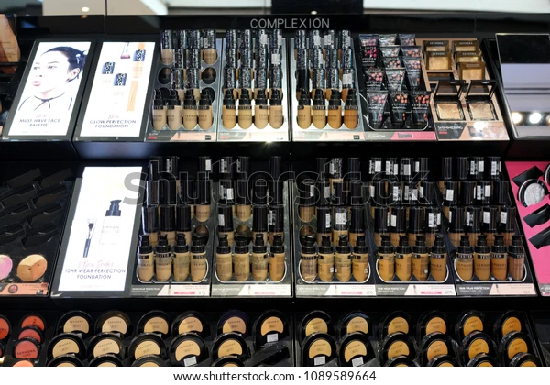
A Day in Alon’s Life
Disinfect, Clean, Organize
Alon Mask
Beauty Advisor @ Goophora
Product Shelf at Goophora
Notes:
Spoken Content
To better contextualize how Google can help transform Goophora, let’s put ourselves in the shoes of Alon Mask, a Beauty Advisor working in Goophora.
Alon’s work day begins with some cleaning and disinfection of her store’s wares.
Inspiration Source - Some interview with a BA
I begin the day with cleaning the counter at the store and organizing the products and other things. Once my counter gets organized, I go ahead and complete all the paperwork that is to be done for the day. And, before the customers begin to flow in I check the available stock of products and compare it with the list that was made the previous day. Once the customers start coming in, I start showing them the cosmetics and makeup products and I also do makeup for those who ask for it.

Slide 7

A Day in Alon’s Life
Stock Take
Alon Mask
Beauty Advisor @ Goophora
Inventory of Goophora
Notes:
Spoken Content
After which, she has to help her branch manager do some stock taking. The way she stocktakes at Goophora is with a pen and clipboard. Alon will go through stock before manually recording the available stock on her clipboard. The clipboard gets passed around multiple people throughout the day and is often nowhere to be found when Alon needs to refer to it. Alon finds this really frustrating and hopes there can be change.

Slide 8





A Day in Alon’s Life
Walk-in Customers
APPT SCHEDULE
Appt 1: 1000 HRS
Appt 2: 1130 HRS
Appt 3: 1730 HRS
Appt 4: 1800 HRS
Customer Interaction, Trainings, Meetings
Customer Appointments
Alon Mask
Beauty Advisor @ Goophora
PDT TRG: 1500 HRS
TEAM MEET: 1600 HRS
Product Training
Team Meeting
Notes:
Spoken Content
Throughout the day, Alon is required to assist walk-in customers. She has to juggle this with customers who have appointments booked with her. Alon records customers appointments in her phone’s calendar and sometimes finds it hard to keep track of her schedule. To make matters worse, Alon also frequently has product trainings to attend. It doesn’t help that her manager frequently slots in team meetings abruptly whenever sales targets for her team aren’t being met. Alon feels overwhelmed and hopes there can be a better way to work.

Slide 9
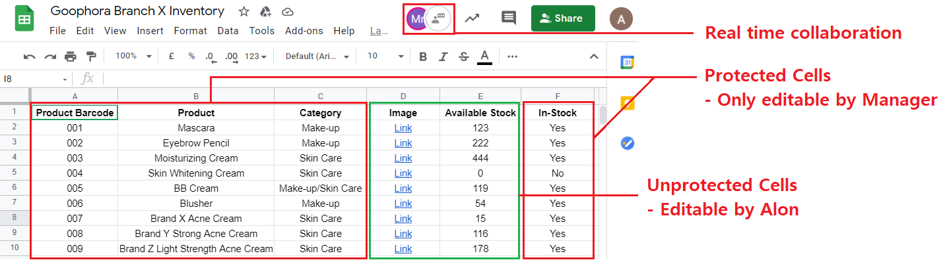
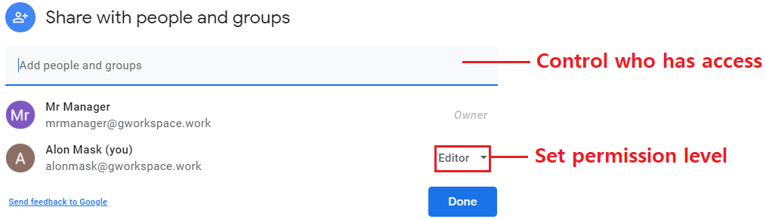
Stocktaking with Google
Inventory of Goophora with Google Sheets
Access Control Panel
Notes:
Spoken Content
Let’s now take a look at how Google can help transform Alon’s workflow.
Starting with Alon’s stocktaking duties - Her pen and paper approach can be replaced by Google Sheets. Google Sheets is a collaborative spreadsheet that allows multiple people to access and edit the sheet at the same time. The practical implication is that Alon can make changes while her manager is supervising the process at the same time. With Google Sheets, Alon can also collaborate with her colleagues. For example, Alon can work on items 1-5, while her colleagues work on items 6-9.
This is as long as they have access to the sheet, which can be easily controlled through the access control panel. Alon’s manager, the owner of the sheet, can easily decide who gets access and the level of permissions they have.
If a fine-grain approach is needed, Google Sheets also support cell level access control. In Alon’s case, her manager has decided that she should only have the ability to make changes to the available stock field. If Alon tries to make changes to other fields, she will receive an error message.

Slide 10
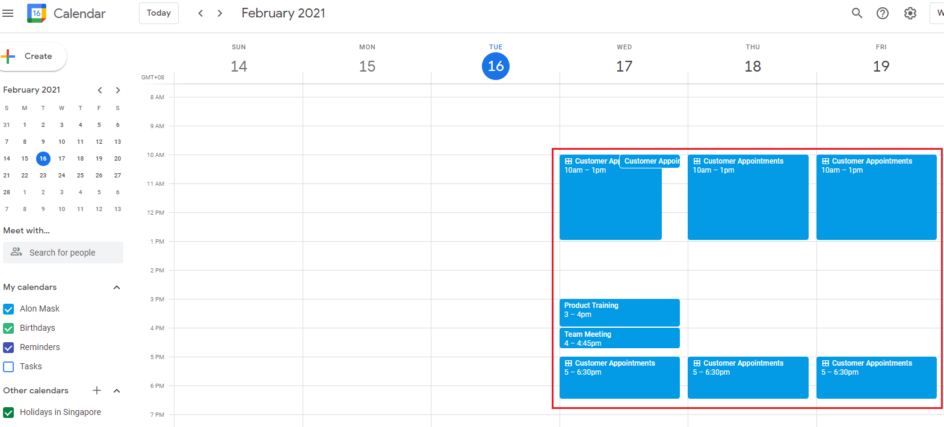
Schedule Management with Google
Alon’s Google Calendar
Notes:
Spoken Content
Google Workspace also offers a Calendar feature which allows Alon to easily manage her daily schedule.

Slide 11
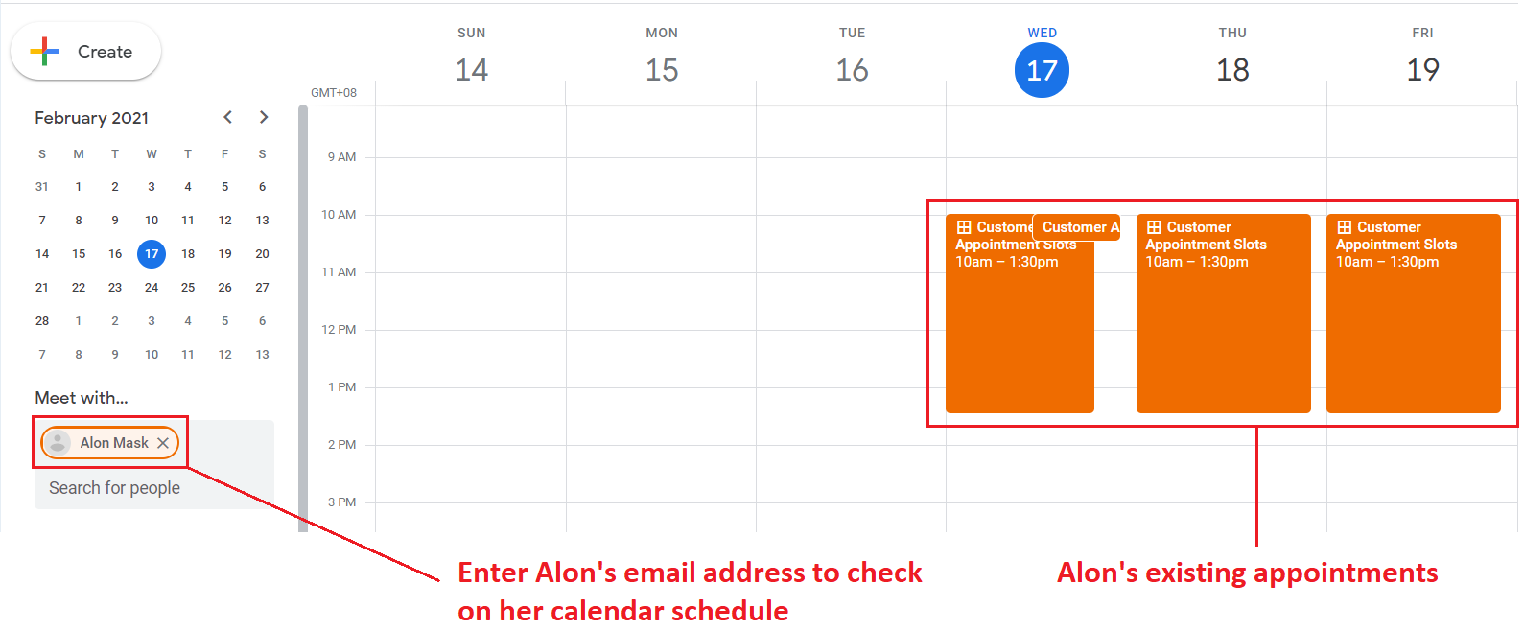
Scheduling Team Meetings with Google
Notes:
Spoken Content
The cool thing about Google Calendars is that you can see the schedules of other members within your organization. For example, we’re now looking at the calendar from the manager’s view. He wants to organize a team meeting. What he has to do is to enter Alon’s name into the search box, and Google Calendar will automatically bring up Alon’s schedule. This way, he can avoid scheduling meetings that clashes with Alon’s other commitments.
What’s also helpful is that Google Calendar will send a reminder 5 minutes before every event. This will really help Alon feel less overwhelmed by the deluge of meetings she has everyday.

Slide 12
Customer Appointment Scheduling with Google
Link to Video
Notes:
Spoken Content
Another amazing feature of Google Calendar is that it allows you to set-up Appointment Slots. For Alon, she can make use of this feature to schedule, organize and manage her customer appointments.
Let’s now watch a video to have a look at the workflow of this process.

Slide 13
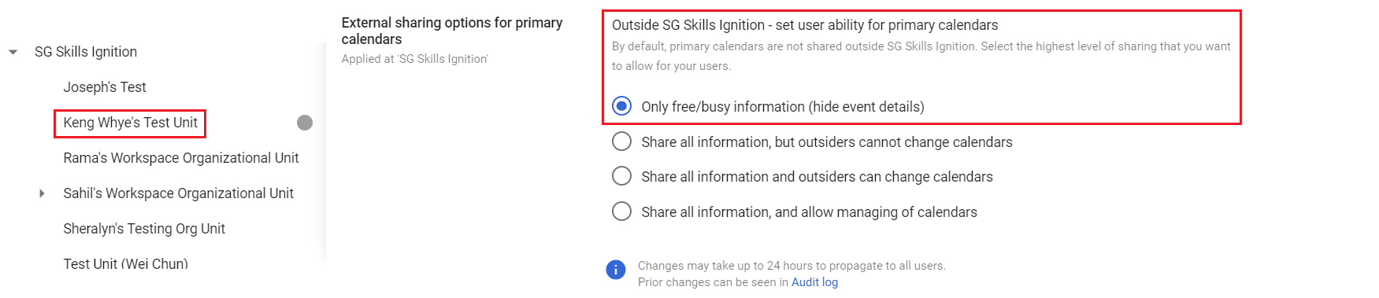
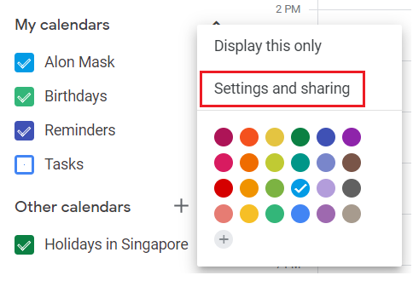
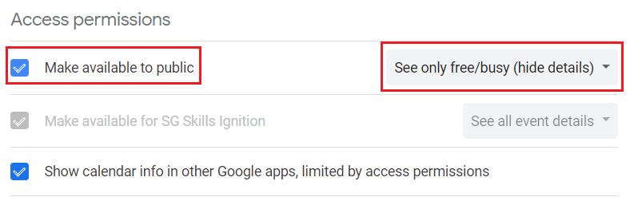
Customer Appointment Scheduling with Google
Admin Panel Calendar Sharing Settings
Alon’s Calendar Sharing Settings
Notes:
Spoken Content From the video, you’ll notice that Alon’s calendar is exposed to the public; this allows the public to make appointment slot bookings with Alon. So what are some of the ways Google can minimize her organization’s exposure to the public?
Specific to the Calendar feature, Google Workspace allows admins to control the level of Calendar exposure to the public. This control can apply to the whole organization, or can apply to a single Organizational Unit. In this case, Alon is grouped under ‘Keng Whye’s Test Unit’ and settings applied to this OU are unique only to this OU and do not affect other OUs.
At a user level, Alon can also decide the level of exposure she has to the public.

Slide 14
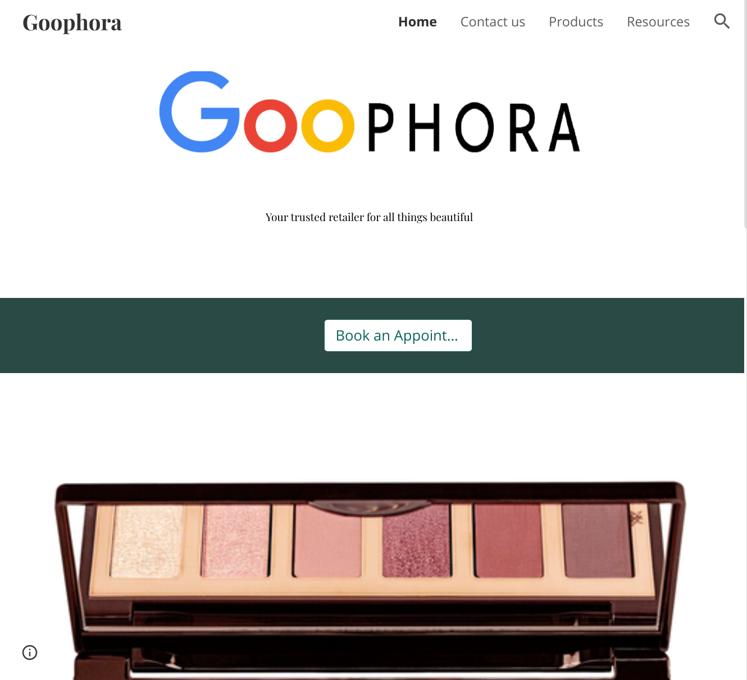
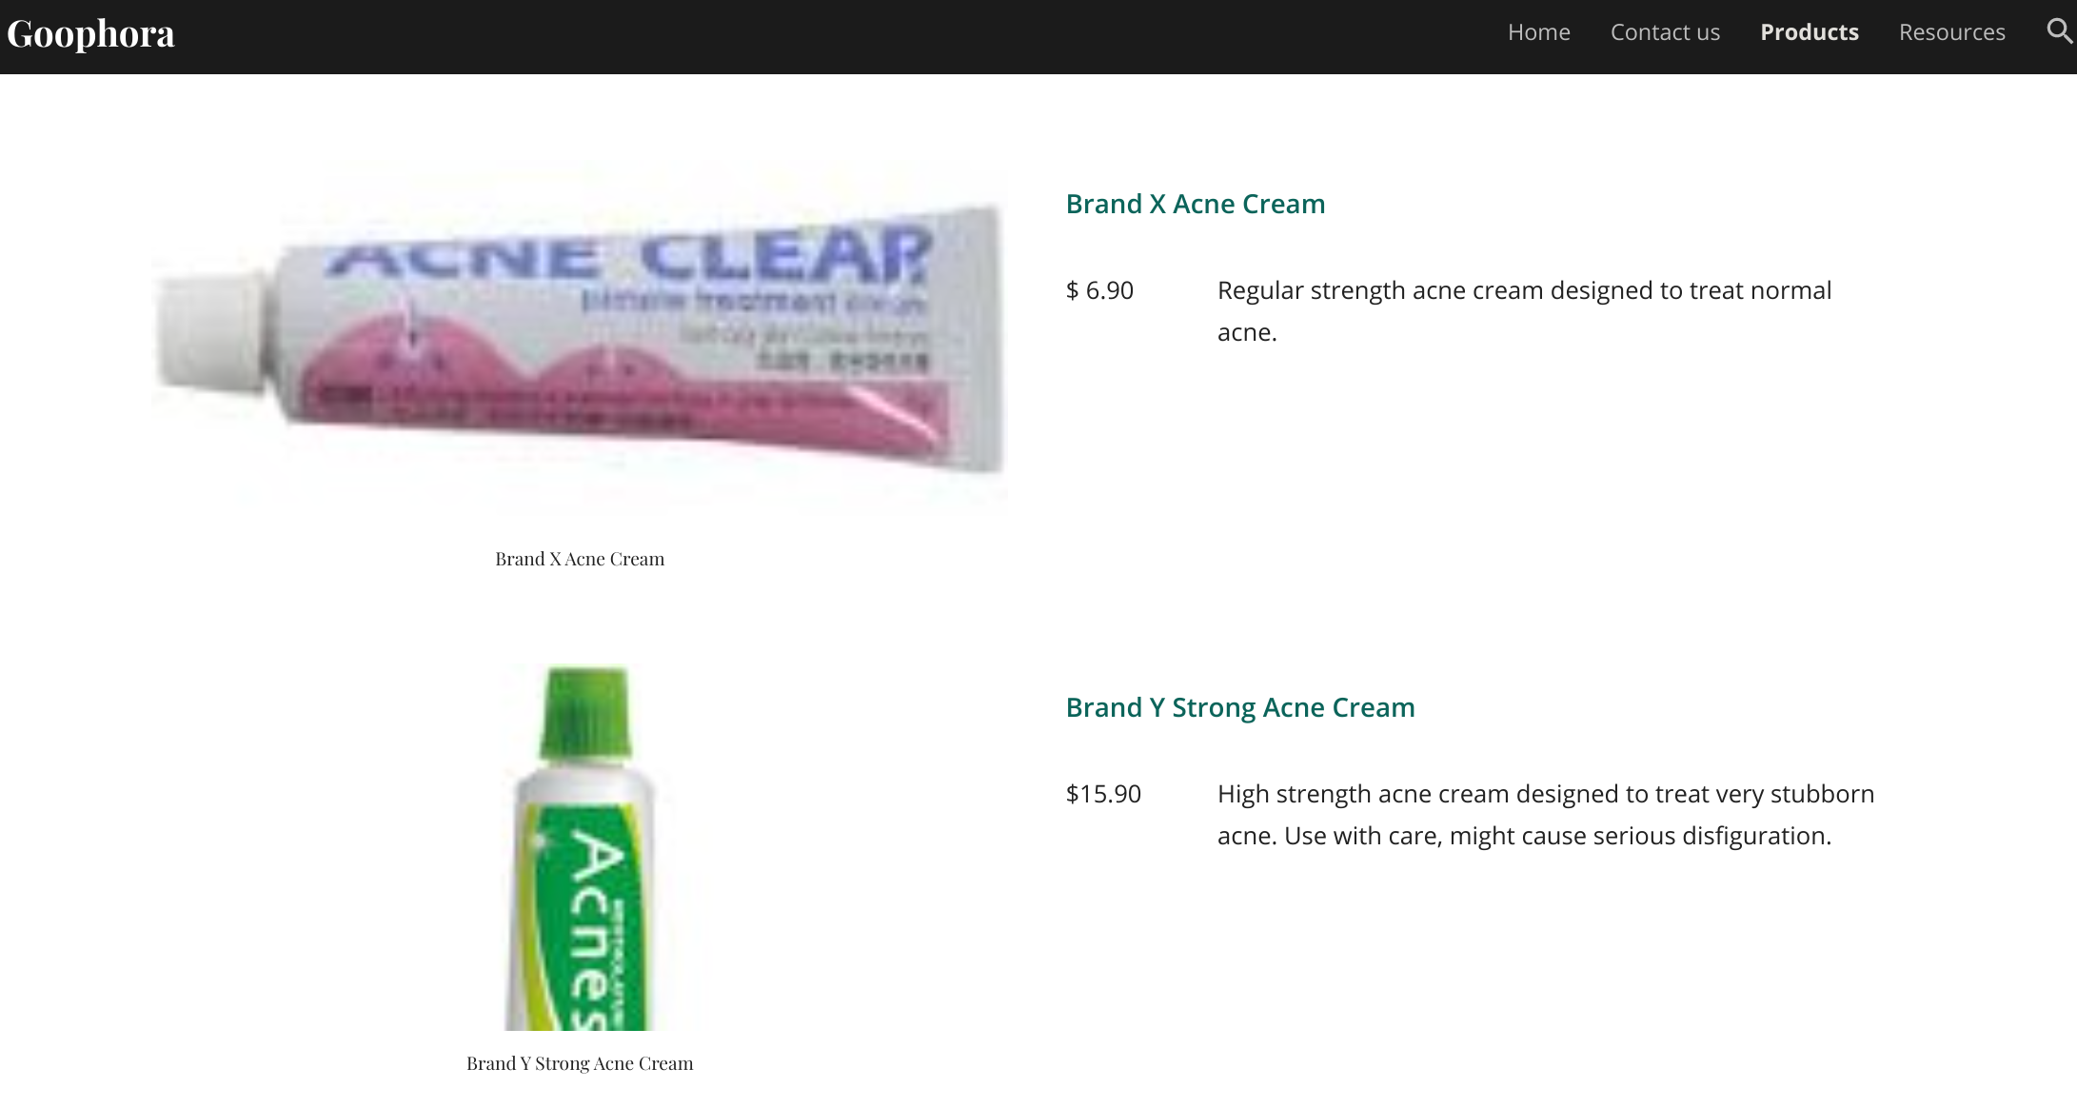
Virtual - Organizing Information Online with Google
Google Sites URL: https://sites.google.com/corp/gworkspace.work/goophora/
Goophora Landing Page
Goophora Product Page
Notes:
Spoken Content
We’ve come to the end of the ‘Human’ portion, moving on to the ‘Virtual’ part.
One of the ways Goophora can organize its product information online is by building a website with Google Sites. Google Sites is a no-code solution and offers many templates. It is a quick and easy way for Goophora to catalog and list its product information online for the customer’s perusal.
Here’s an example of how Goophora’s website may look with Google Sites.

Slide 15
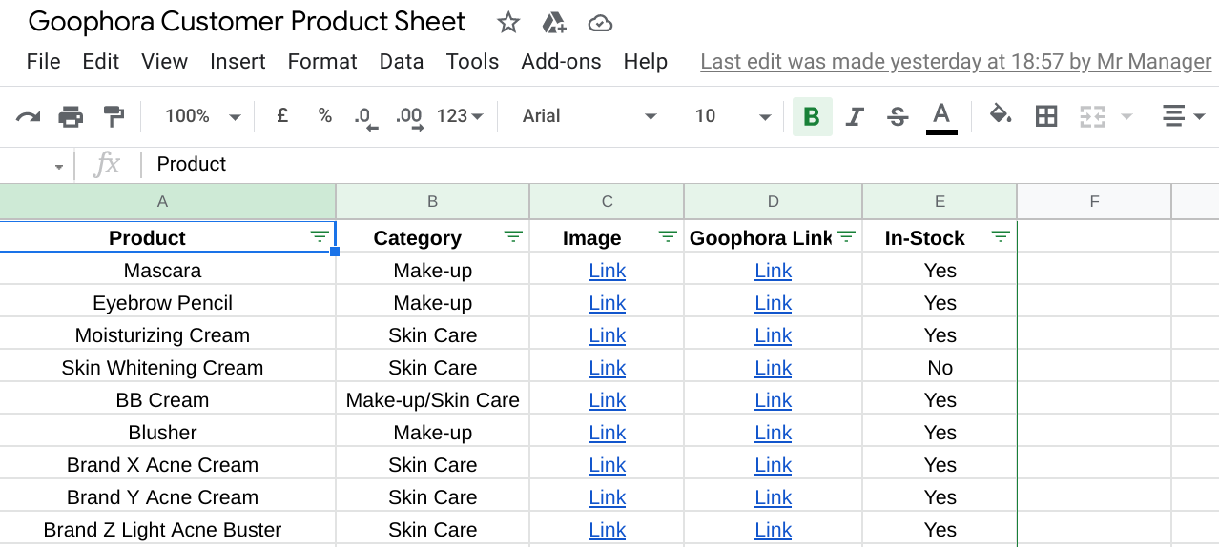
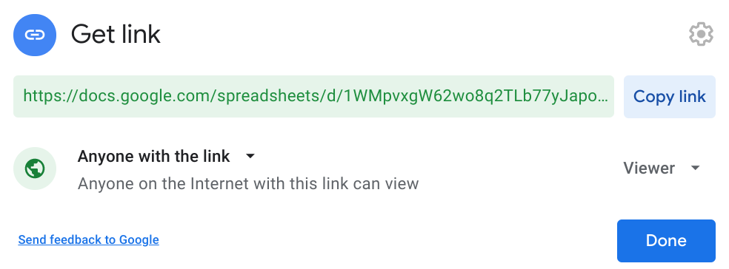
Virtual - Organizing Information Online with Google
Product Catalog
shared with customer
Column linked to Stock-Taking Sheet
Shared with Public but only ‘Viewer’ access given
Notes:
Spoken Content
Google Sheets can also provide an easy way for Goophora to share its product information with customers.
In this example, we’re making use of Google Sheet’s Sheet-Linking feature to provide real-time stock availability updates. Recall Alon’s earlier stocktaking sheet - This sheet is linked to that sheet. Therefore, as Alon or her colleagues carry out stocktaking, this sheet is updated real-time and customers can know whether the product they want is in-stock or not in-stock.
Like the earlier example, Google Sheet makes it easy for Sheet owners to control access. In this case, the sheet is shared to the public, but only viewer access is given.
If desired, Goophora can improve on the usability of this Sheet by transforming it into an application through Google’s AppSheet. AppSheet is a no-code app-building solution that allows companies to easily prototype and publish highly functional apps.

Slide 16

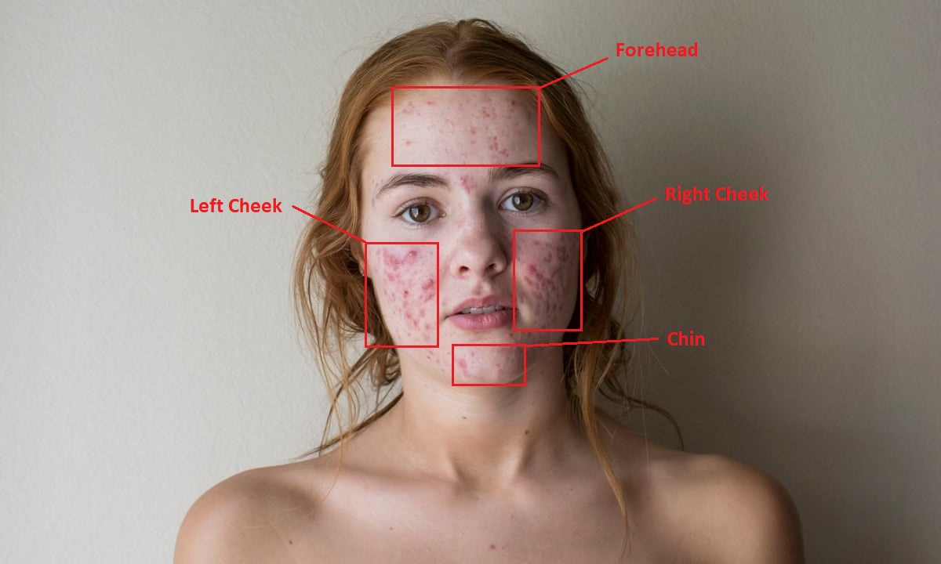
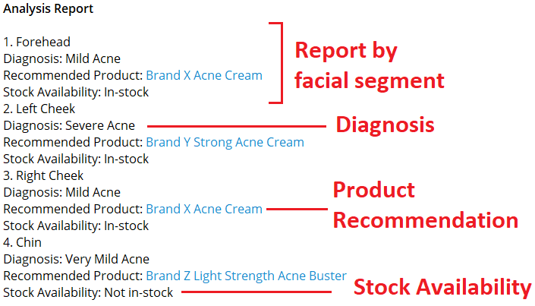
Virtual - Goophora’s Virtual Beauty Advisor
Product Recommendation from Facial Analysis
Input
Output
Cloud Vision
Machine Learning
DialogFlow
Notes:
Spoken Content
Finally, moving on to the more interesting stuff. Here’s a feature that Goophora might be able to build using Google Cloud’s Machine Learning offerings.
This feature - The ‘Product Recommendation from Facial Analysis’ takes a photo from the user as input, then tags different parts of the user’s face and performs a diagnosis on the different facial parts. Based on the diagnosis, products from Goophora will then be recommended.
In this example, we’ll only be diagnosing whether there is acne or not. And we’ll be able to assess the severity of the problem and recommend products based on the severity.

Slide 17
Virtual - Goophora’s Virtual Beauty Advisor
Product Recommendation from Facial Analysis
API Microservice
Frontend
Cloud Vision API
User Photo
3rd Party
Chat Apps
Data
OR
ML Model(s) (GCP AI Platform)
DialogFlow
Workspace API
Frontend
User
OR
3rd Party
Chat Apps
DialogFlow
Notes:
Spoken Content
So here’s one possible way that this feature can be built. In this approach, we’re going to be packaging Google’s Cloud Vision API and various Machine Learning models and Workspace APIs into a single API call.
Cloud Vision API is responsible for identifying the face in the photo and to tag different parts of the face. Then, Goophora can custom train machine learning models that detect different problems. In our example, we’ll have a model that can detect if there is acne or not. This model can be trained through Google Cloud’s AI platform.
When a user makes a request from a frontend service - It can be Google’s dialogflow or a 3rd party chat application - Our packaged API will receive the input and generate and output and route it to the frontend. The user can then access the output from the frontend service.

Slide 18
Virtual - Goophora’s Virtual Beauty Advisor
Product Recommendation from Facial Analysis
Link to Video
Notes:
Spoken Content
Now I have a video to showcase how this feature might possibly work when it's built.

Slide 19
Cost of Transformation
No AppSheet Support
Starts at: $6/seat/mth (SMB)
Starts at: $10/seat/mth (Enterprise)
Variable costs - Depends on usage & architecture
AppSheet Support
$30/seat/mth (Enterprise)

Slide 20

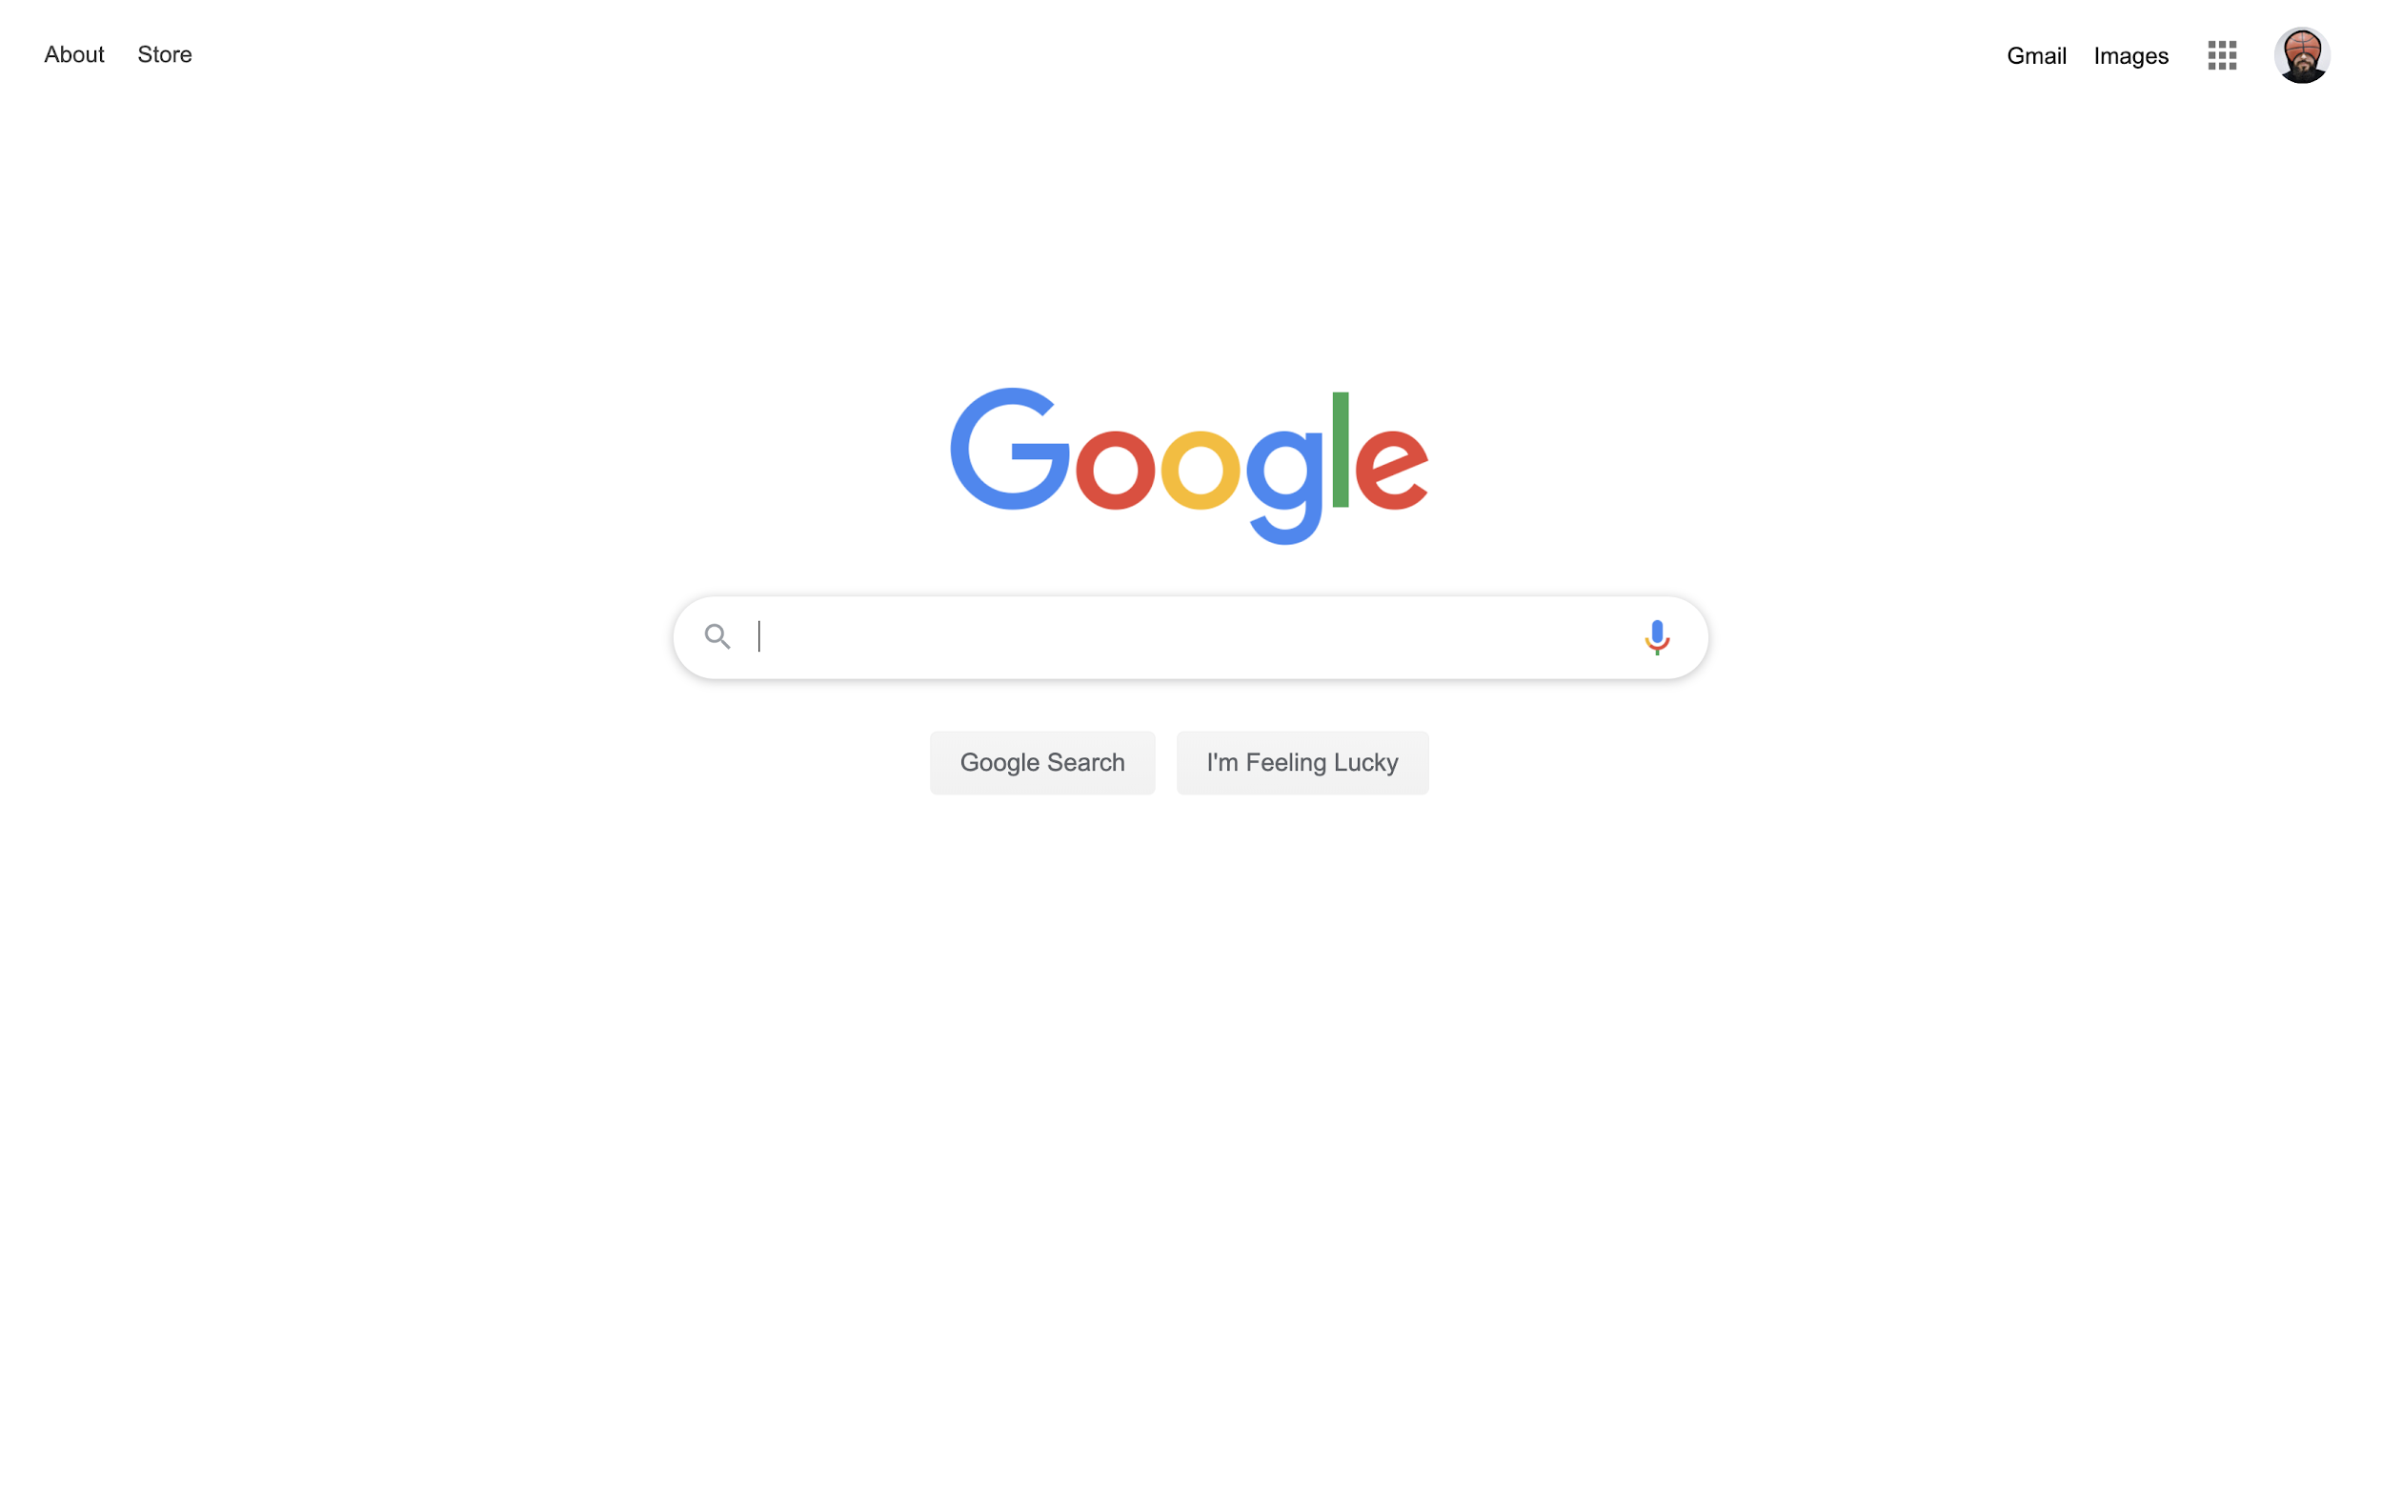
Questions?
Notes:
Feedback/Improvements:
1. Try to include slide/content to highlight ‘Why Google’ -> Differentiation from competitors - Possible differentiating points:
(i) ML offerings are leading the market
(ii) Big user base -> Easier to convince mass market adoption
(iii) Usability -> Everything integrated together, UI/UX is good
2. Try to include examples of other companies’ success story using Google - Companies from a similar industry will be preferred

